Slide 1
Amateur Basketball League Manager
Team 3: Chris Downing, Ross Hoyt, Alex Peterson

Slide 2
Project Mission Statement:
The purpose of this database application is to manage the operations of an amateur basketball league.

Slide 3
Core Functionality -
Application has three user groups: players, administrators, and referees
Players will use app to sign up as a team or an individual, and view schedules
Administrators will use app to coordinate seasons of gameplay. This includes:
Scheduling matches between teams
Ensuring adequate facilities and equipment are available
Setting referee schedules
In general, ensuring no scheduling conflicts between matches, facilities, referees, teams
Referees will use app to view their schedule of matches they are assigned to
Application may also track performance statistics of teams and players

Slide 4
External Models:

Slide 5
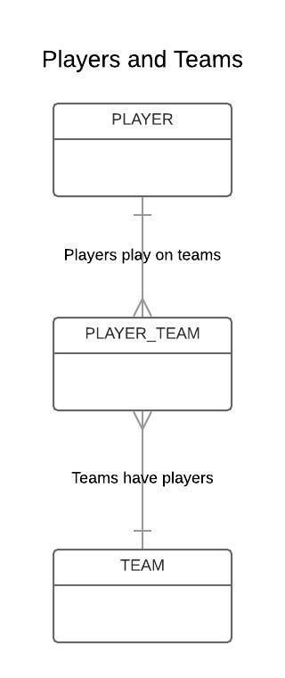
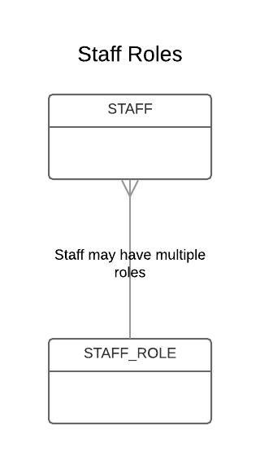

Slide 6
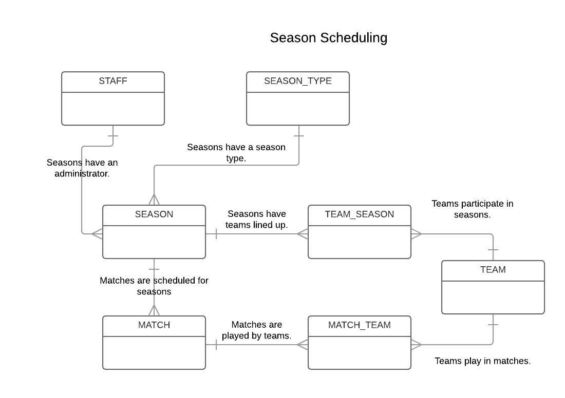

Slide 7
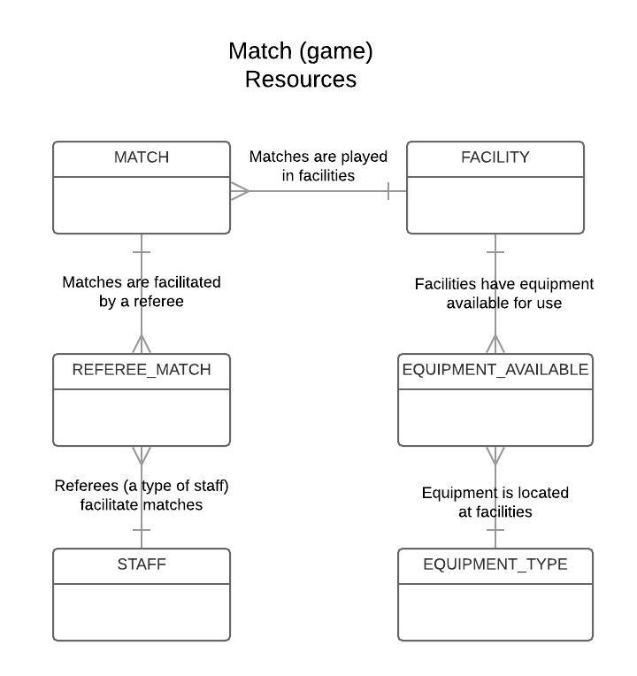

Slide 8
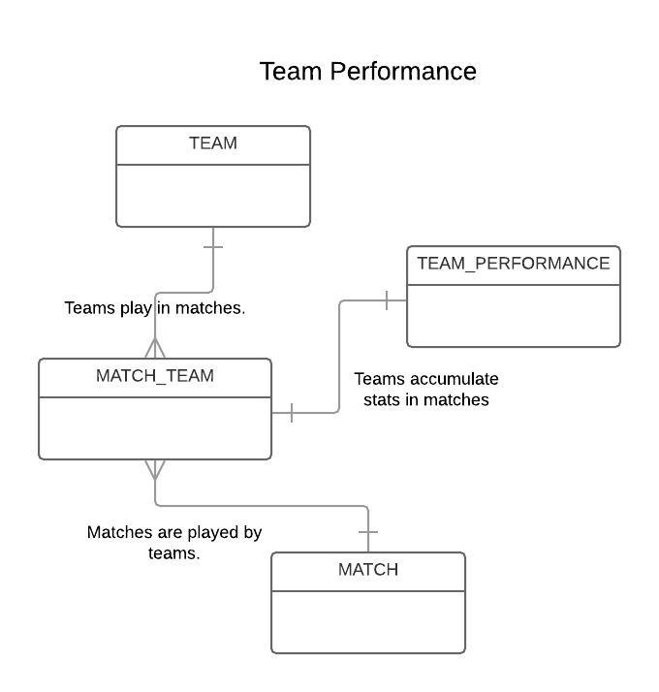
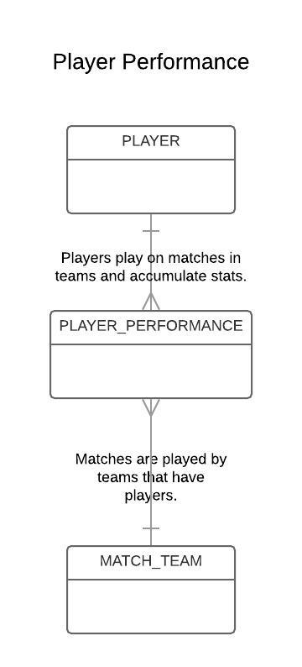

Slide 9
Conceptual Model:

Slide 10
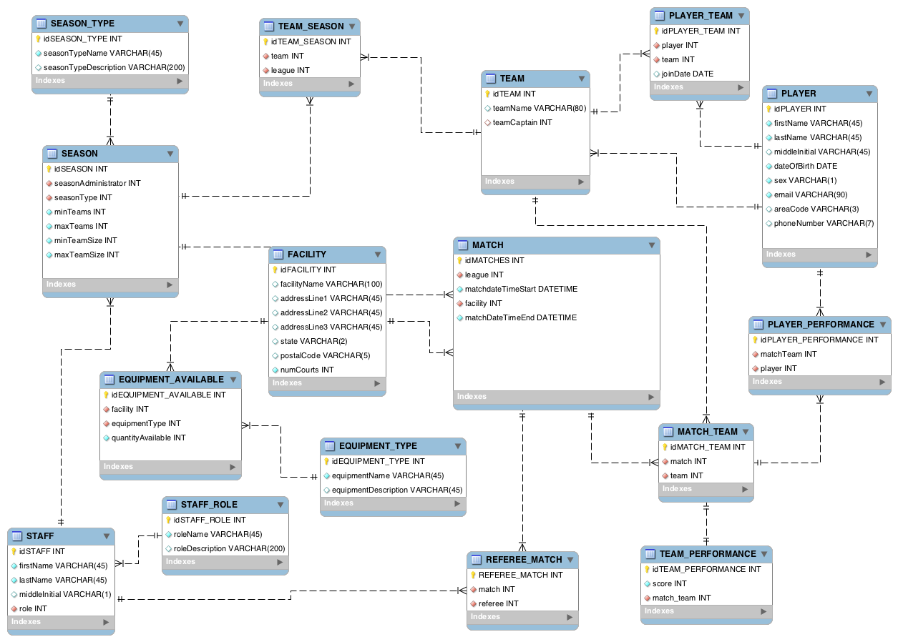

Slide 11
Questions?

